Slide 1



Ice Cream Particulate Monitoring Station
(ICPMS)

Slide 2

Objective
Our group 119 has set our main goal to monitor the amount of ice-cream particulate in the atmosphere in order to create a healthy lifestyle for our future generations.

Slide 3



Our Team Members
Karthik Manivannan
Sam Soney Chemparathy
(3108292)
karthimani1907@gmail.com
(3108222)
samsoney.edu@gmail.com

Slide 4

License
We have a permissive open source license which is a non-copyleft open source license. This guarantees the freedom to use, modify while having minimal restrictions and requires nearly nothing.

Slide 5
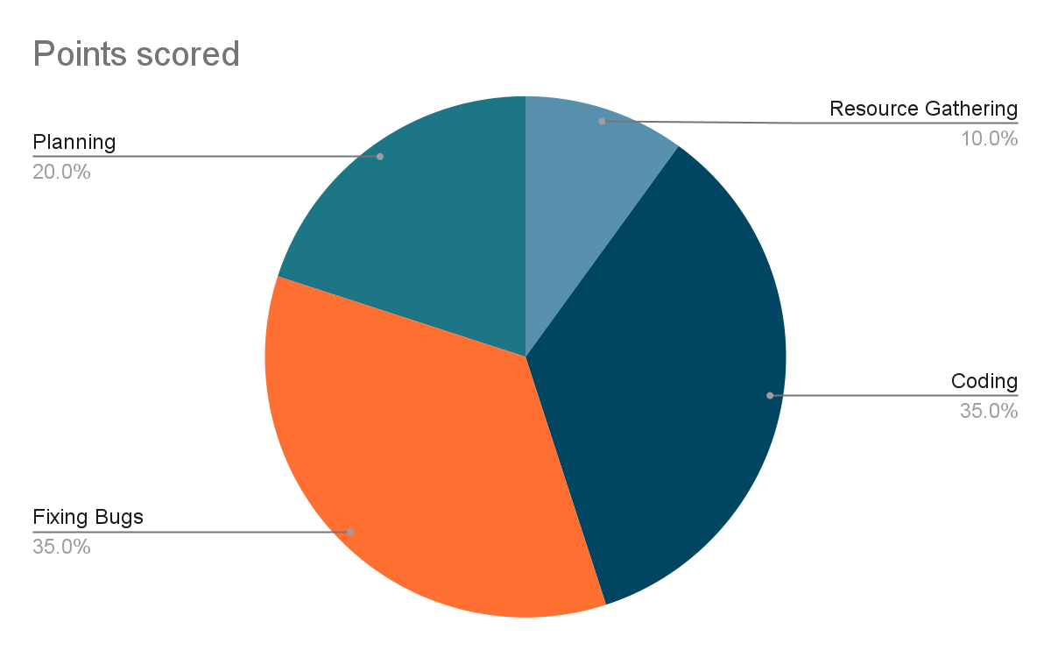
Timeline

Slide 6
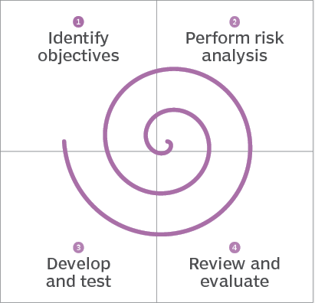
Our Process Model
The spiral model is a software development lifecycle (SDLC) method used for risk management that combines the iterative development process model with elements of the Waterfall model.

Slide 7

Our Product
A web application that acts as an interface between the permitted user and the data that helps him/her make game changing decisions for the well being of our society. The user is able to gather information from the database while also being able to update the database with newer observations. The database consists of data taken from various monitoring stations across many states.
The system can also show the target, the variations and the current status.
Furthermore, we have given an additional layer of security that ensures that the data is kept safe from malicious users.

Slide 8

UML Diagram
Notes:
Unified Modeling Language (UML) A visual language for specifying, constructing, and documenting the artifacts of systems.

Slide 9
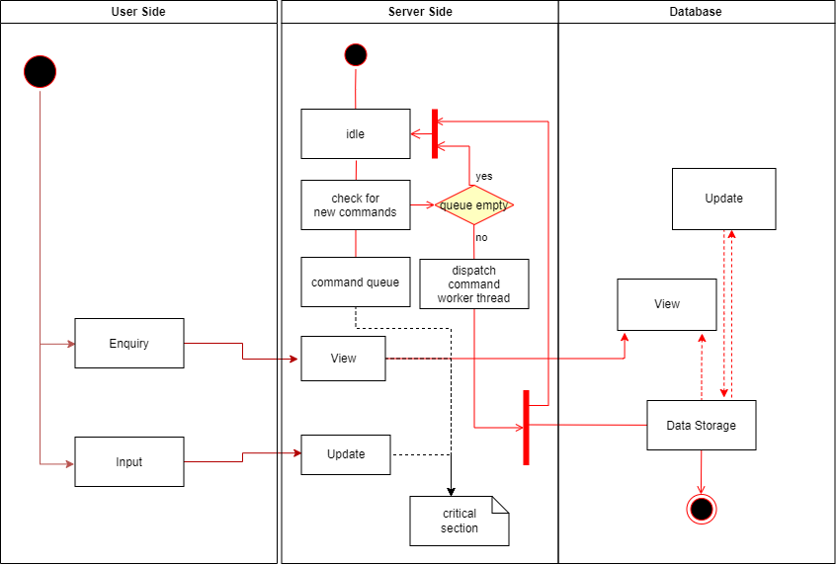

Slide 10
Technologies used
Asp.net - MVC
C# & javascript -Programming language
Html & CSS - UI Design
.Net 4.8 FrameWork
MSSQL - Database control

Slide 11

Here is a demo

Slide 12
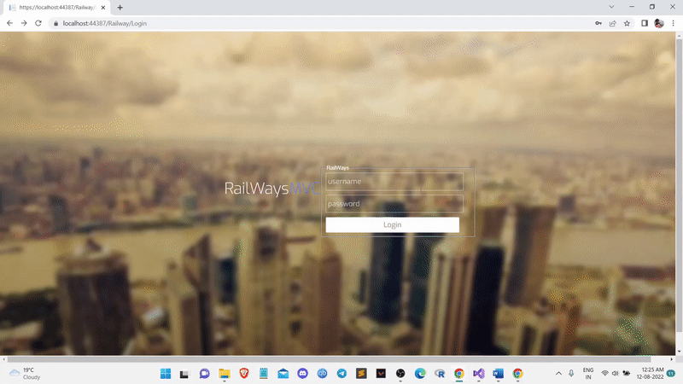

Slide 13
Future Implementations
Auto updation of data via IOT implementation
Faster data collection and execution
Unlimited users and data inputs
Trend prediction with AI
Healthcare progression
International access
Mobile applications

Slide 14

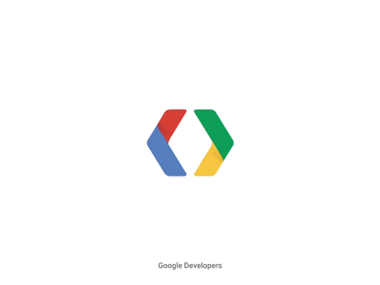


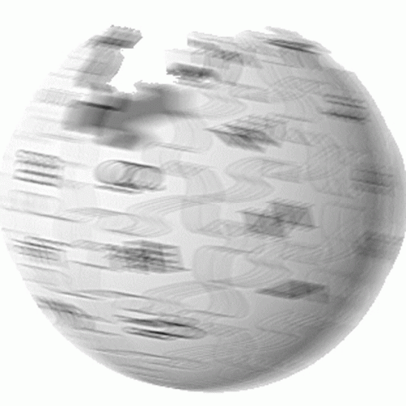
References:
Software Development Lecture Notes
Google Developer Students Club
Link to get the Idea of the project
Link for the Data Set
Codepen.io
Wikipedia

Slide 15
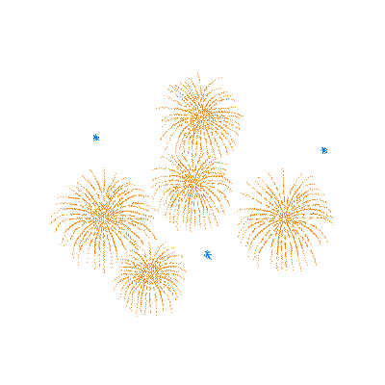

Thank You

